Slide 1
College Recommendation System

Slide 2
GROUP MEMBERS :
ALCINA JUDY 01
KESHA D’CRUZ 12
JANHAVI KATHE 32
GUIDE:
Prof. Kirti Motwani
(Asst. Prof. Computer Engineering Department, XIE)

Slide 3
AGENDA
1. Problem Statement
2. Flow Chart
3. Methodology
4. Output
5. Conclusion

Slide 4
PROBLEM STATEMENT
The college selection plays an important role as college selection requires a lot of searching work. Searching for a good college is a tedious task for a student who wants to pursue his/her higher studies. Students search for various aspects like college campus, teaching staffs, extracurricular activities in colleges, infrastructure of colleges, etc., even the reviews of college is searched to get extra confirmation about the details. College Recommendation System will recommend good colleges to a student based on his/her choice of field, top ratings, location and CGPA. It is important as it reduces the manual work and automates this with the help of software.

Slide 5
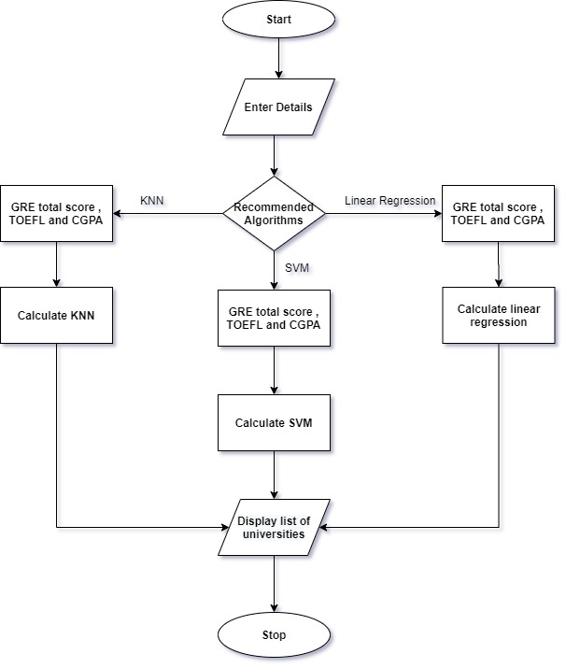
FLOW CHART

Slide 6
METHODOLOGY USED IN SYSTEM
Linear Regression
K-nearest neighbors
K-means
Support Vector Machines
Popularity
Content based filtering

Slide 7
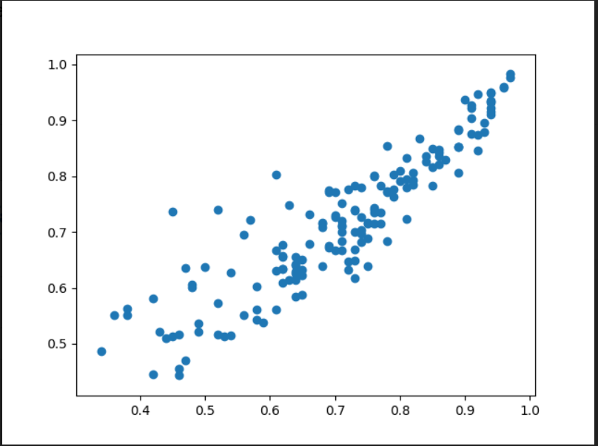
LINEAR REGRESSION
Finds Relationship Between inputs
Formula of linear Regression : Y=mX+C
The accuracy of linear regression is 81%.

Slide 8
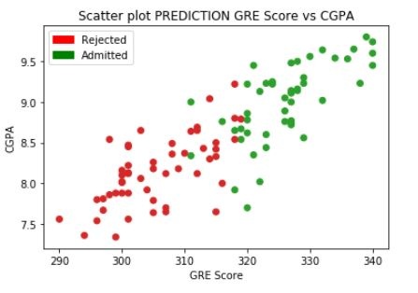
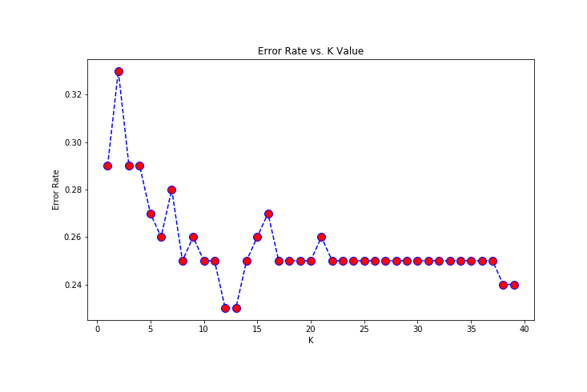
K-NEAREST NEIGHBORS
KNN is K-nearest neighbors that is K number of neighbors.
Can be used to solve both classification and regression problems.
The accuracy of KNN is 91%

Slide 9
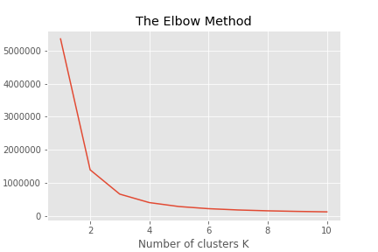
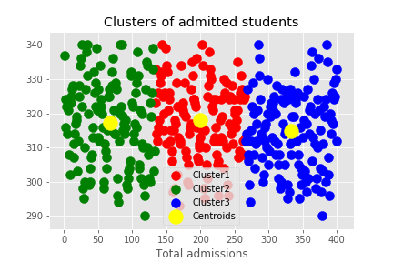
K-MEANS
K clusters, which can be used to label new data.
K-means Graph- Elbow Method K-means Graph- Clusters of admitted students

Slide 10
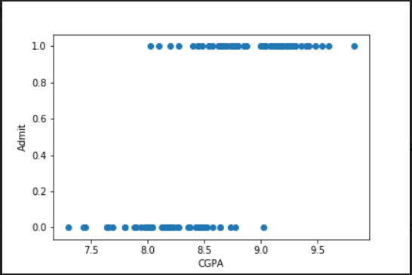
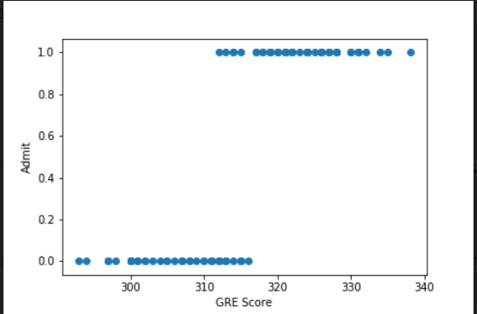
SUPPORT VECTOR MACHINE
SVM is supervised learning algorithm which are used for classification and regression.

Slide 11
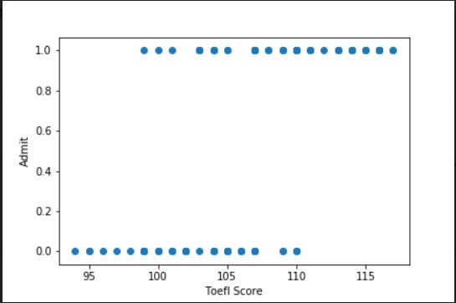

Slide 12
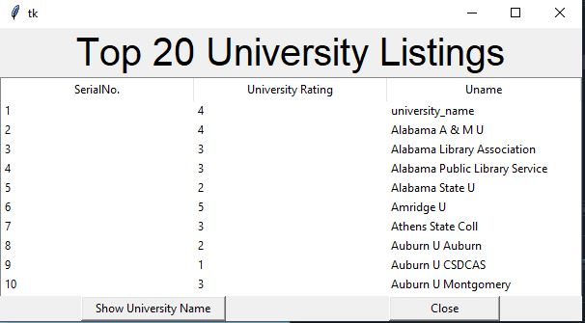
POPULARITY
Used for University Rating

Slide 13
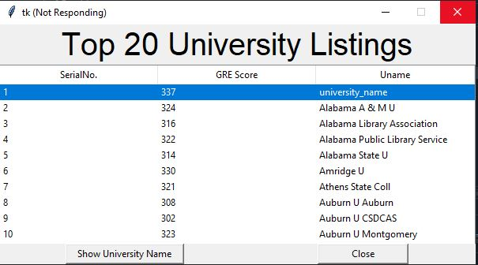
CONTENT BASED FILTERING
Used to list the top University on basis of GRE score

Slide 14

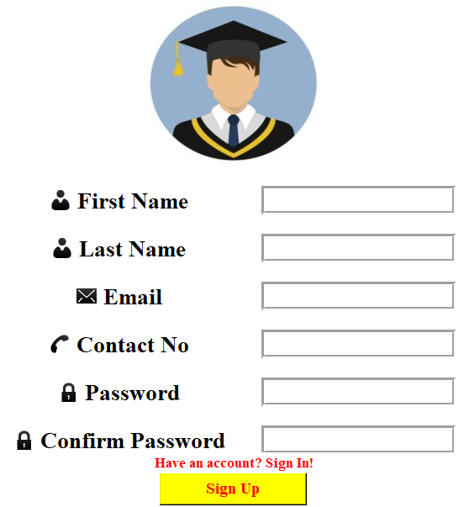
OUTPUT

Slide 15
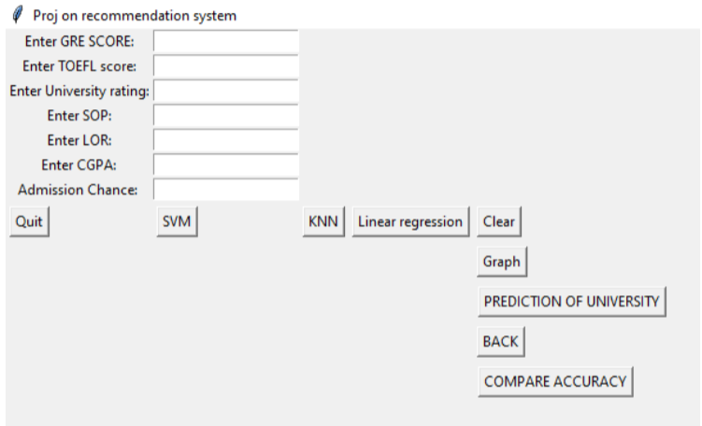

Slide 17
CONCLUSION
We have applied KNN, SVM and linear regression on the attributes such as CGPA, GRE, and TOEFL.
KNN gives preference to GRE score, SVM gives preference to CGPA and Linear Regression gives preference to TOEFL score
Hence the conclusion is that in this recommendation system KNN gives the highest accuracy that is 91% as compare to SVM and linear regression which is 81% and 83% respectively by comparing the graphs of each model.
We have studied new features of python language as list box, tables, graphs, TKINTER and animation.

Slide 18
THANK YOU

